Slide 1


Laplace Transforms
12/8/2008
Carlos Lazo
Christopher Rappa
Jake Tisdale
Michael Sangillo

Slide 2
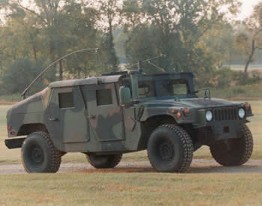
Problem Statement
Requirements
  Max sway space is 0.25”
  Max permissible force is 100 lbf
HMMWV (High-Mobility Multipurpose Wheeled Vehicle)

Slide 3
System Diagram
The MKS system will be used throughout this presentation.
Electronics Box
M = 5.6699kg
X₂ (electronics displacement)
Damper B = 1.23948 Ns/m
Spring Stiffness K = 2709.57 N/m
X₁ (truck bed displacement)

Slide 4




Part 1 – Derive the differential equation that govern the system
Initial condition:
  System is at rest
  X1 and x2 are at their local zeros
M=mass=5.6699kg
k=spring constant=2709.57 N/m
b = damper constant=1.23948 Ns/m
Requirement:
  Derive differential equation.

Slide 5

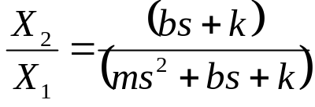
Part 2 – Deriver Transfer Function
Transfer Function
Requirement:
  Derive Transfer Function by taking the Laplace Transform of the differential equation.

Slide 6


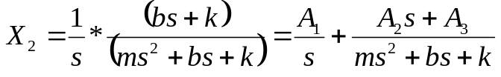



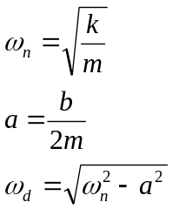

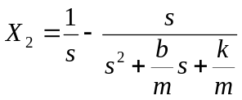



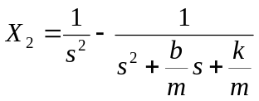



Part 3 – Hand Calculation
Step Input
Ramp Input
Using s=0, s=1 and s=2
Using s=0, and looking at the s³, s² and s¹ terms:
Requirements:
  Calculate system response to step function.
    Apply step input, take the inverse Laplace transform to get x2(t)
      Use partial fraction decomposition and Laplace transform pair table
  Calculate system response to ramp function
    Apply ramp input, take the inverse Laplace transform to get x2(t)
      Use partial fraction decomposition and Laplace transform pair table

Slide 7
Part 4 – MATLAB Transfer Function Model
MATLAB TF Code
nums = [B k];
dens = [M B k];
t = 0:tr:tm;
Ts = tf(nums,dens);
[mags,phases,ws] = bode(Ts);
x2sm = step(Ts,t);
x2rm = lsim(Ts,t,t);
Requirements:
  Use TF to create a Matlab transfer function
  Apply a step input using the STEP function
  Apply a ramp input using the LSIM function

Slide 8


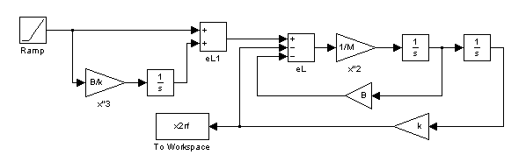
Part 5 - Simulink Model
Requirements
  Construct 3 Simulink models
    Construct the transfer function version
      Consists of input, transfer function block, and output
        1 Model for step
        1 Model for ramp
    Construct the physics version
      Consists of a representation of F=ma
        can’t do step because velocity > ∞
        1 Model for ramp

Slide 9
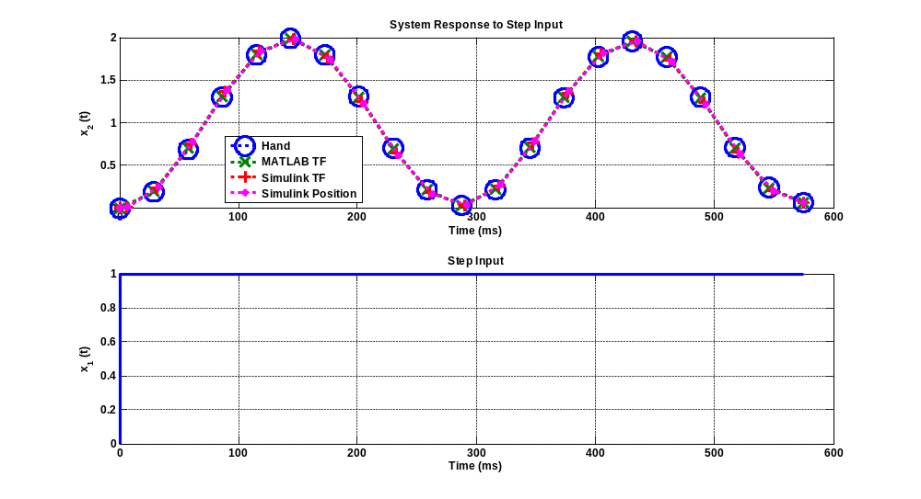
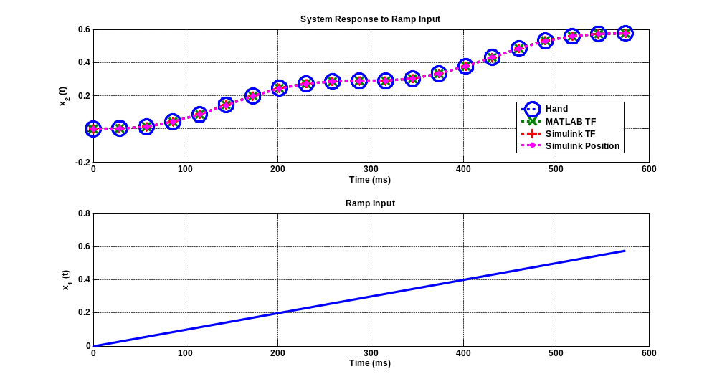
Part 6 – Compare Results
Requirement
  Plot the 3 results of the step input on 1 graph
  Plot the 4 results of the ramp input on 1 graph
  The results should be very close

Slide 10


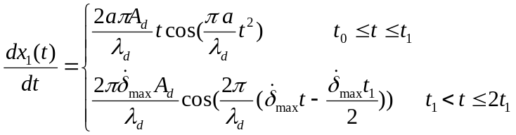



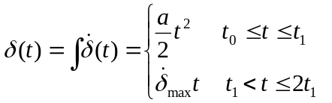





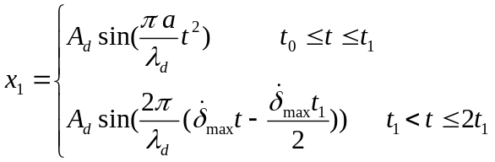
Part 7 – Mathematically describe Complex Input
Requirements
  Derive a mathematical expression for dx/dt.

Slide 11
Part 8 – Use Simulink to Simulate Complex Input
Requirement:
  Simulate terrain input with Simulink
  Plot x1(t) and x2(t) on the same plot.

Slide 12
Part 9 – Determine Relative Displacement
Requirement:
  Plot the relative displacement.
    The relative displacement should violate the sway space requirement.
  Plot the force.
    The force should violate the max permissible force requirement.

Slide 13
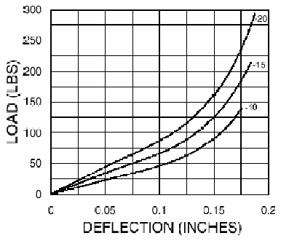
Part 10 – Select a New Isolator
Used straight line approximation
k=spring damper=175,126.835 N/m = 175.126 kN/m
Requirement:
  Use the Barry Controls design guide and catalog to estimate K and B for the T-44-AB-15 isolator.

Slide 14
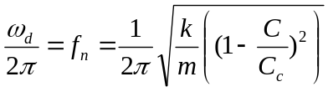
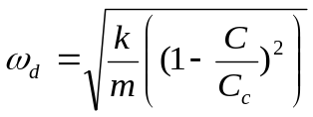
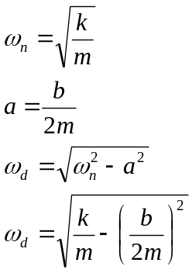
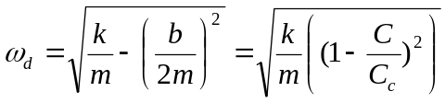
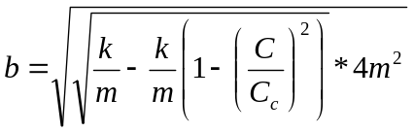
Part 10 – Select a New Isolator Con’t
Solve for New b:
b = Damper= 24.45162 Ns/m
Requirement:
  Use the Barry Controls design guide and catalog to estimate K and B for the T-44-AB-15 isolator.

Slide 15
Part 11 – Simulate System with New Isolator
Requirement
  Use Simulink to simulate system with new isolator.
  Plot x1(t) and x2(t) on the same plot.
  Plot the new relative displacement and verify that it now meets specification.
  Plot the new force and verify that it now meets specification.

Slide 16
Part 12 – Compare the Two Responses
Requirements:
  Plot the input x1(t), and the two outputs x2(t) (the non-isolated and the isolated response) on the same plot.
  Plot the force transmitted to the box for the non-isolated and the isolated case on the same plot.

Slide 17
Part 13 – Create Bode Plots
Requirement:
  Use the BODE function on your Matlab TF models to get the Bode plot of both systems.
  Plot both Bode magnitudes on the same plot to show how the resonance is removed from our frequencies of interest.

Slide 18
Conclusion

